Slide 1

Sample Size Calculation From the Basics to Advance
Zehui Bai
Senior Biostatistician II
13-Dec-2024

Slide 2
Part I: Introduction

Slide 3
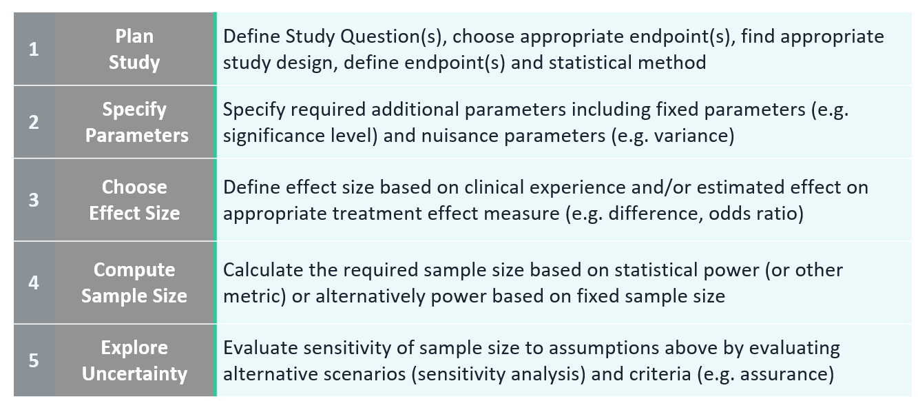
5 Essential Steps for Sample Size Determination

Slide 4
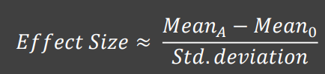
How to estimate Effect Size
Use background information in the form of preliminary/trial data to get means and variation, then calculate effect size directly
Use background information in the form of similar studies to get means and variation, then calculate effect size directly
With no prior information, make an estimated guess on the effect size expected, then use an effect size that corresponds to the size of the effect
Broad effect sizes categories are small, medium, and large
Different statistical tests will have different values of effect size for each category

Slide 5
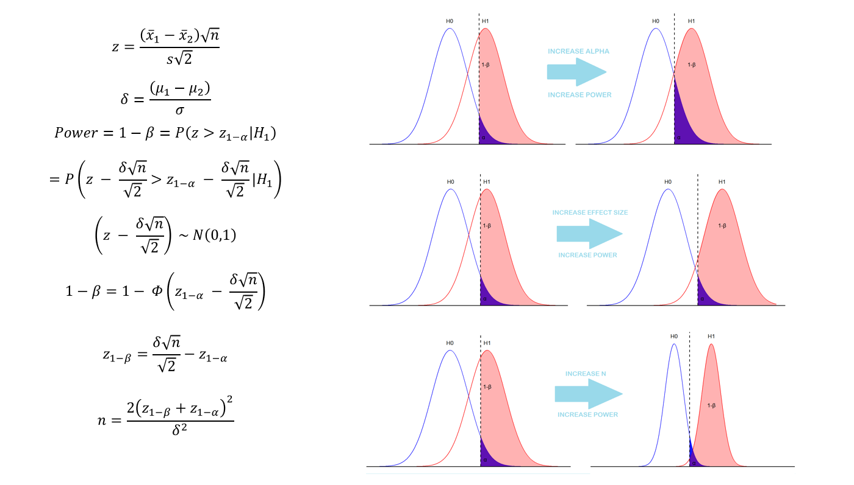
Importance of Statistical Power

Slide 6
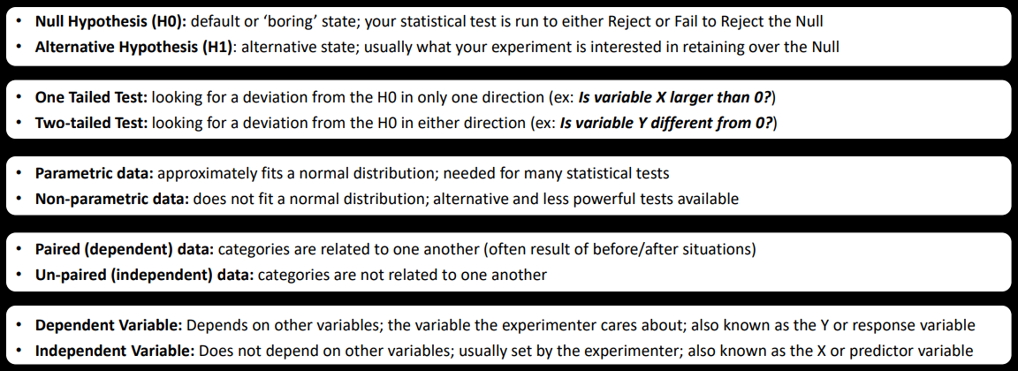
Key Bits of Sample Size Calculation
Effect size: magnitude of the effect under the alternative hypothesis.
The larger the effect size, the easier it is to detect an effect and require fewer samples
Power: probability of correctly rejecting the null hypothesis if it is false.
The higher the power, the more likely it is to detect an effect if it is present and the more samples needed
Significance level (α): probability of falsely rejecting the null hypothesis even though it is true
The lower the significance level, the more likely it is to avoid a false positive and the more samples needed

Slide 7


Study Design
Study Design
Single Arm Trial | Proportion-Based Endpoints: Compare the observed response rate to a historical or hypothesized rate: Expected response rate and Null response rate Mean-Based Endpoints: Compare the mean outcome to a predefined threshold
Randomized Controlled Trial (Continuous Outcome) | Expected difference between group means Pooled standard deviation
Randomized Controlled Trial (Binary Outcome) | Proportion in control group and intervention group
Survival Analysis | Hazard ratio (HR). Median survival times in groups. Accrual and follow-up periods. Censoring rate.
Cluster Randomized Trials | Intra-cluster correlation (ICC). Average cluster size
Equivalence or Non-Inferiority Trials | Equivalence margin or non-inferiority margin
Diagnostic Accuracy Studies | Expected sensitivity/specificity Desired margin of error. Prevalence of the condition in the population.
Non-Parametric Approach | E.g. Wilcoxon Rank-Sum Test
Group Sequential Design and Adaptive Design | Number of planned interim analyses, efficacy and futility boundaries, sample size re-estimation
Bayesian Approach | Sample Size Based on Posterior Probabilities

Slide 8
Practical Tools within ICON for Sample Size Calculation
Tools
nQuery Software | Supports group sequential, adaptive designs, and Bayesian approaches. Provides visual outputs to aid in decision-making.
SAS Proc Power | Supports a range of study designs, including t-tests, survival analysis, regression, and equivalence testing. Comparing Means (T-tests): proc power; twosamplemeans test=diff mean1 = 50 mean2 = 55 stddev = 10 Comparing Proportions: proc power; twosamplefreq test=chi p1 = 0.6 p2 = 0.8 Survival Analysis: proc power; logrank hazardratio = 0.7 refsurvival = 0.6 accrualtime = 12 followuptime = 24
R Packages | pwr, pwrss: For basic power and sample size calculations. BayesTools, Stan: For Bayesian sample size estimation. gsDesign: supports group sequential clinical trial design rpact: supports confirmatory adaptive design, simulation, and analysis
R Shiny | A Shiny app consists of two parts: UI (User Interface): Handles the layout and input/output elements. Server: Contains the logic and calculations. An excellent way to create interactive web applications for users to calculate sample size dynamically.

Slide 9
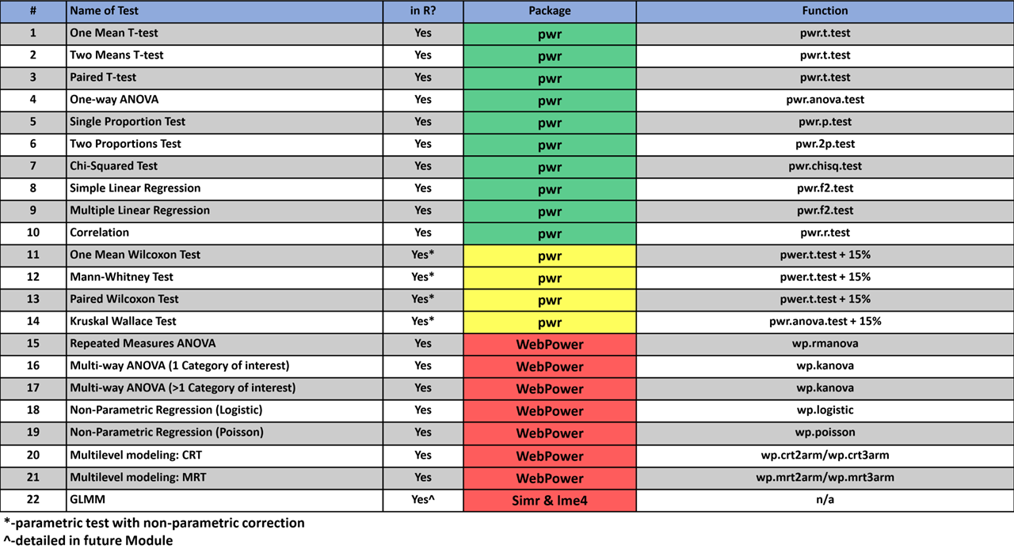

Slide 10
Part 2: SSD using R pwrss

Slide 11
R pwrss
Function | Description
power.f.test | Statistical Power for the Generic F Test
power.t.test | Statistical Power for the Generic t Test
power.z.test | Statistical Power for the Generic z Test
pwrss.f.ancova | Analysis of (Co)Variance (F test)
pwrss.f.anova | Analysis of (Co)Variance (F test)
pwrss.np.2groups | Difference between Two Groups (Non-parametric Tests for Independent and Paired Samples)
pwrss.np.2means | Difference between Two Groups (Non-parametric Tests for Independent and Paired Samples)
pwrss.t.2means | Difference between Two Means (t or z Test for Independent or Paired Samples)
pwrss.t.mean | One Mean against a Constant (z or t Test)
pwrss.z.2means | Difference between Two Means (t or z Test for Independent or Paired Samples)
pwrss.z.2props | Difference between Two Proportions (z Test)
pwrss.z.mean | One Mean against a Constant (z or t Test)
pwrss.z.prop | One Proportion against a Constant (z Test)
https://cran.r-project.org/web/packages/pwrss/index.html
install.packages("pwrss")
library(pwrss)
Bulus, M. (2023). pwrss: Statistical Power and Sample Size Calculation Tools. R package version 0.3.1. https://CRAN.R-project.org/package=pwrss

Slide 12
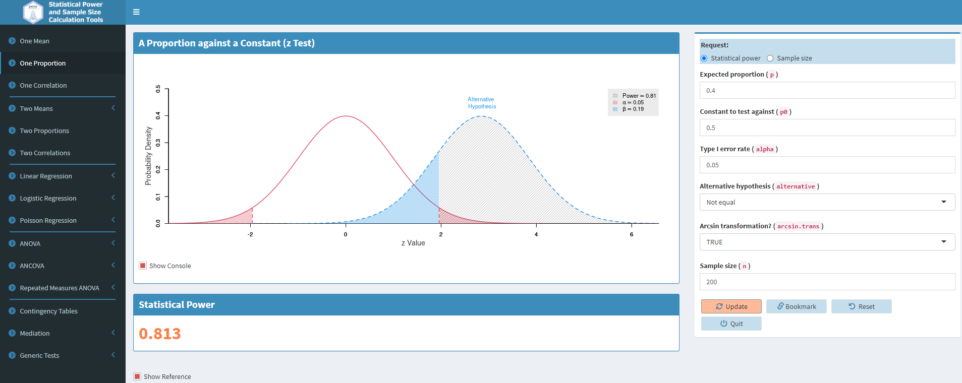
Shiny Apps
https://pwrss.shinyapps.io/index/
Notes:
[Power and Sample Size Tool]
https://steve-mallett.shinyapps.io/WWApr24Power/

Slide 13
Part 3: Visualization for SSD

Slide 14
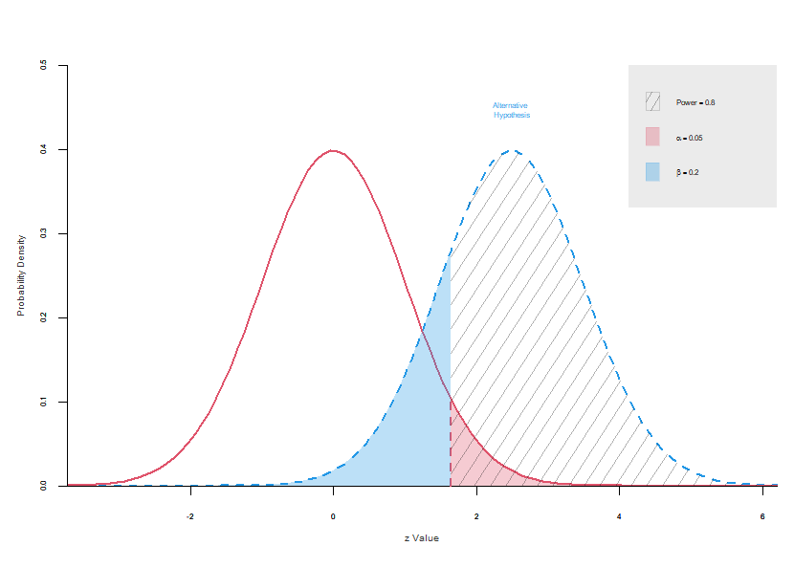
Visualization – Power Plot under H0 and H1

Slide 15
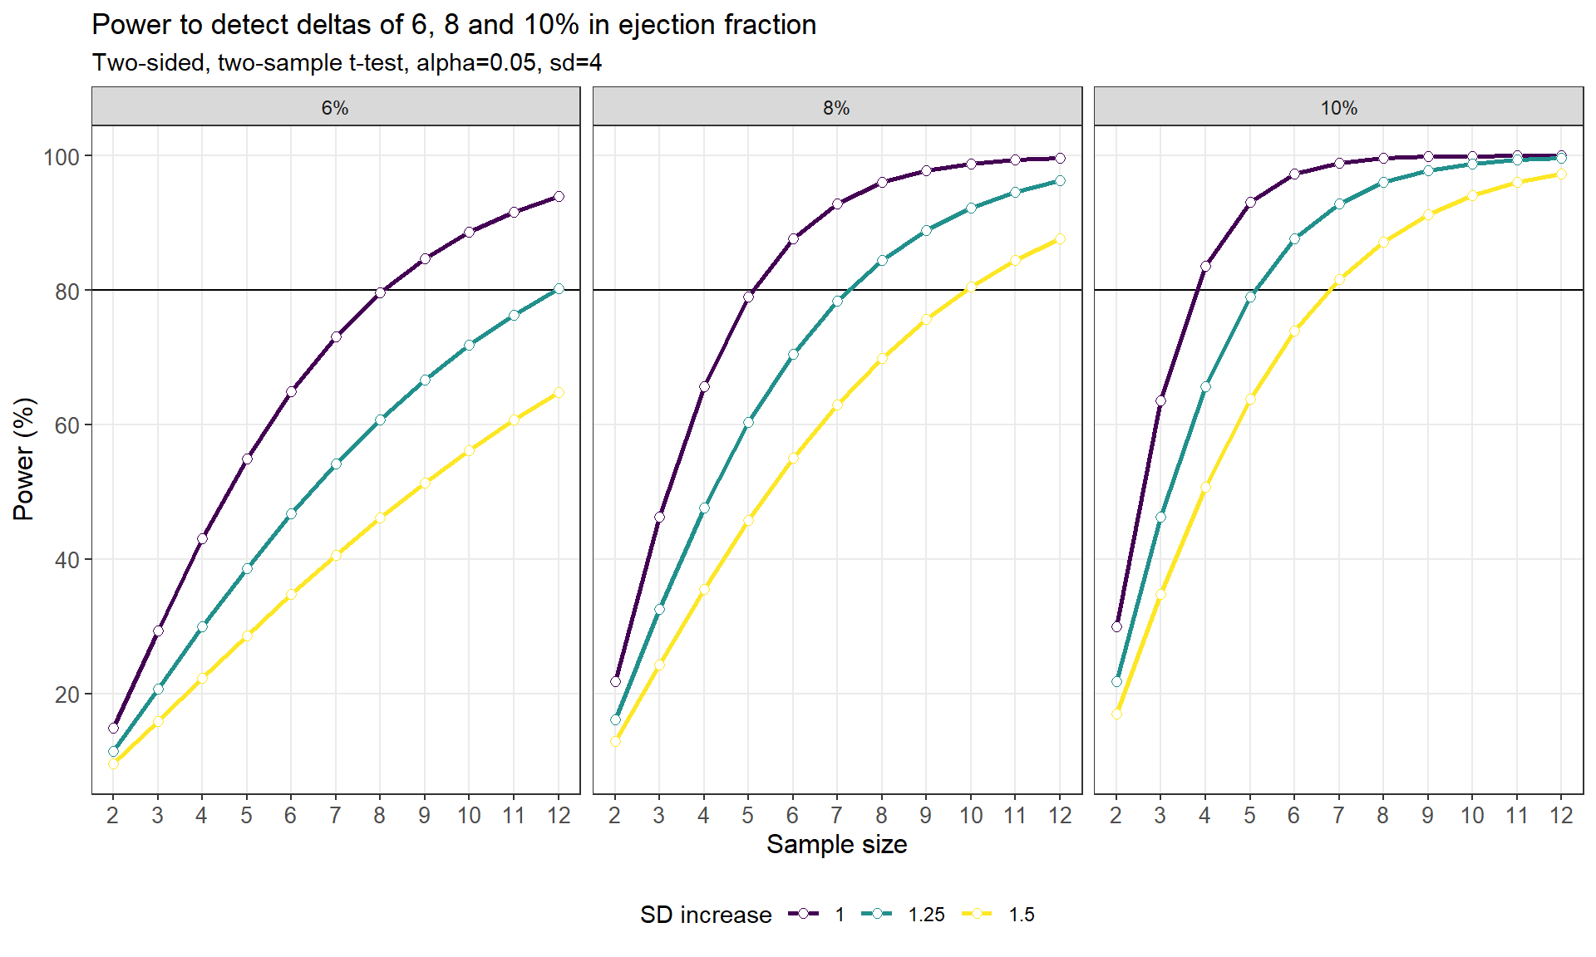
Visualization – Trellised Power Curves
Notes:
[Power and Sample Size Tool](https://steve-mallett.shinyapps.io/WWApr24Power/)

Slide 16
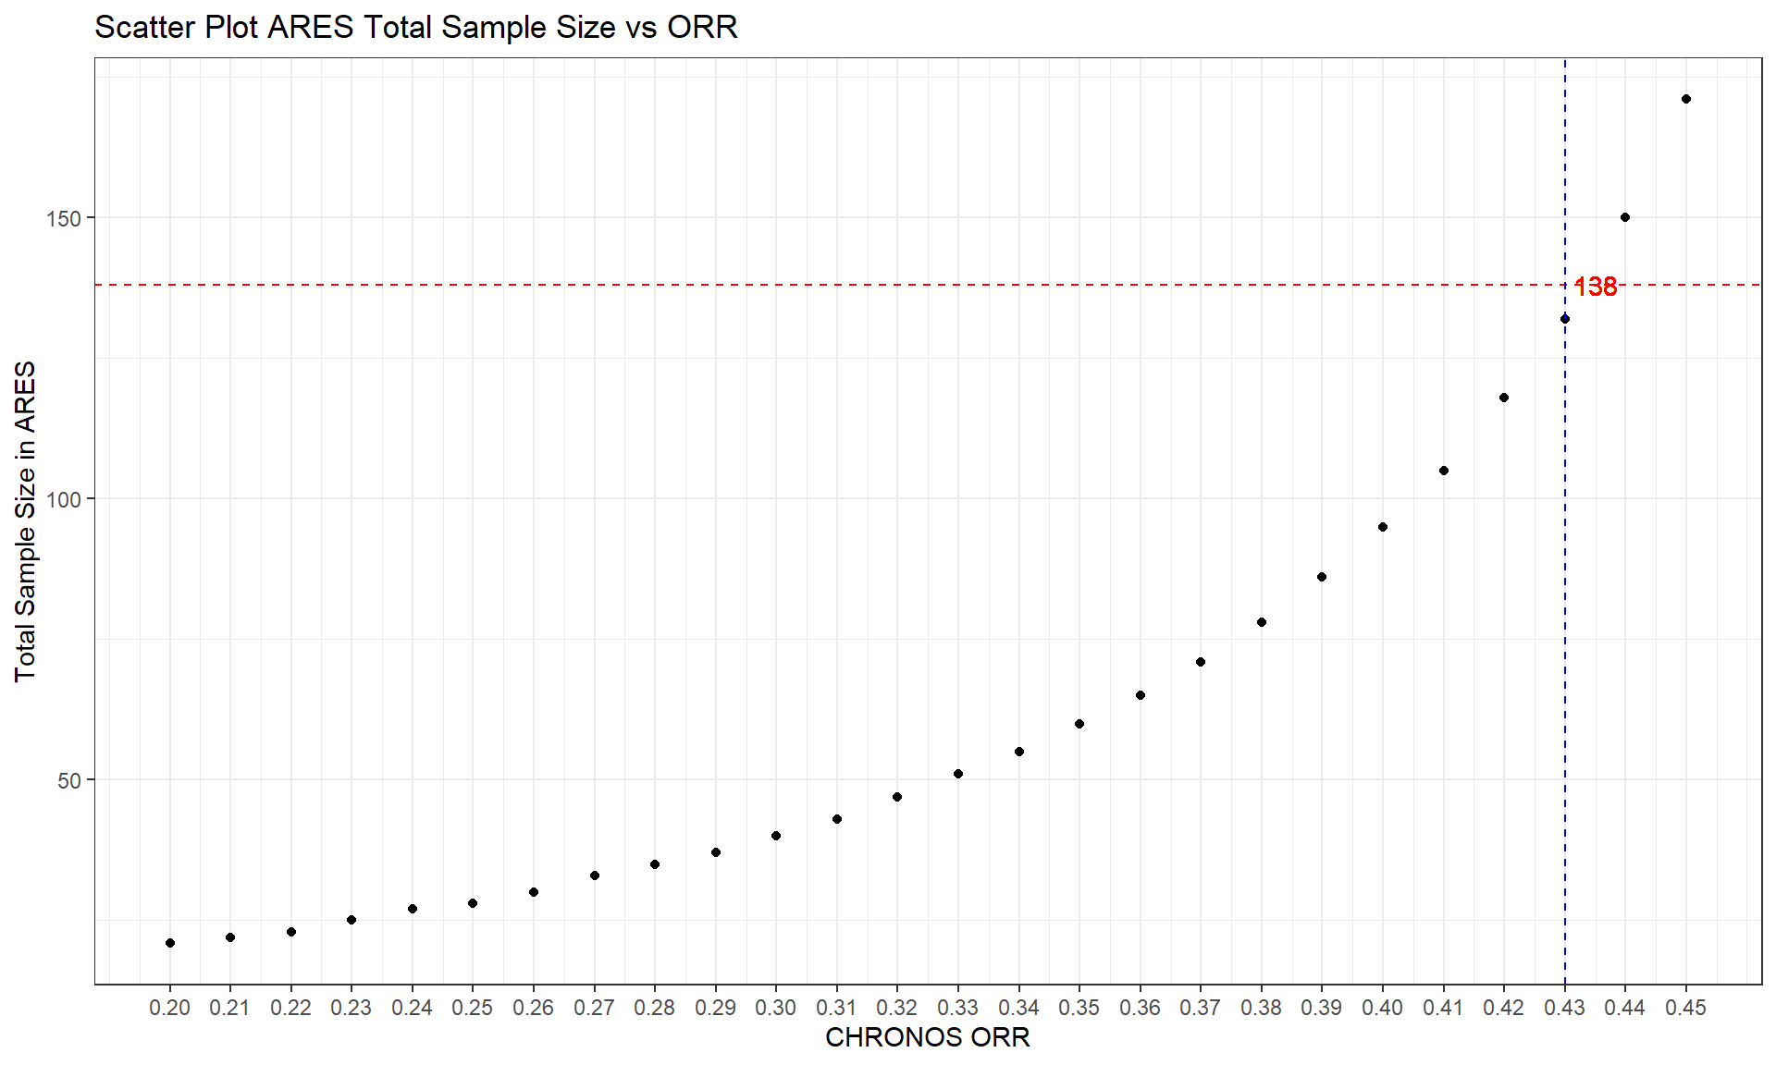
Visualization – Trellised Power Curves with Hit Point

Slide 17
Reference
1. Julious, S. A. (2023). *Sample sizes for clinical trials* (2nd ed.). CRC Press.
2. Chow, S. C., Shao, J., Wang, H., & Lokhnygina, Y. (2017). *Sample size calculations in clinical research.* Chapman and Hall/CRC.
3. Machin, D., Campbell, M. J., Tan, S. B., & Tan, S. H. (2018). *Sample sizes for clinical, laboratory and epidemiology studies.* John Wiley & Sons.
4. Ryan, T. P. (2013). *Sample size determination and power.* John Wiley & Sons.
5. Cohen, J. (2013). *Statistical power analysis for the behavioral sciences.* Academic Press.
6. Bulus, M. (2023). *pwrss: Statistical Power and Sample Size Calculation Tools.* R package version 0.3.1. Retrieved from [https://CRAN.R-project.org/package=pwrss](https://CRAN.R-project.org/package=pwrss).
7. Bulus, M., & Polat, C. (in press). *pwrss R paketi ile istatistiksel guc analizi [Statistical power analysis with pwrss R package].* Ahi Evran Universitesi Kirsehir Egitim Fakultesi Dergisi. Retrieved from [https://osf.io/ua5fc/download](https://osf.io/ua5fc/download).

Slide 18






ICONplc.com
© 2023 ICON. All rights reserved.

